Slide 1

August 2018
Congestion and Urban Density
Institute of Couriers

Slide 2
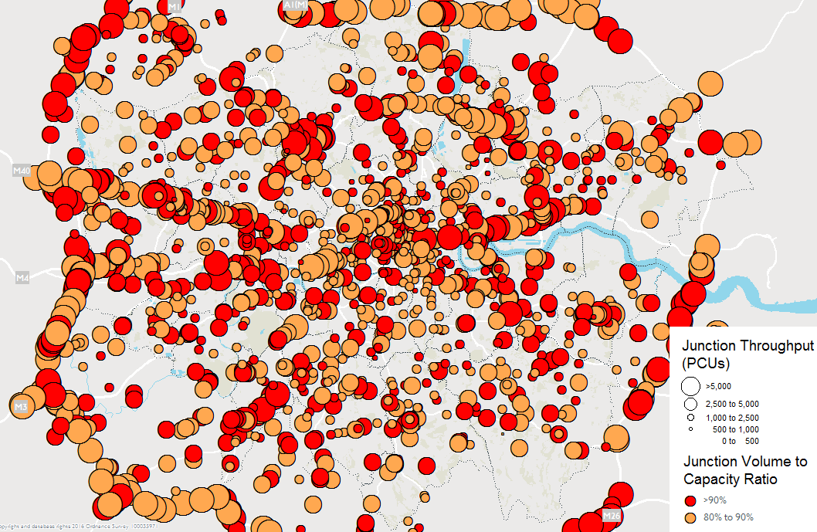
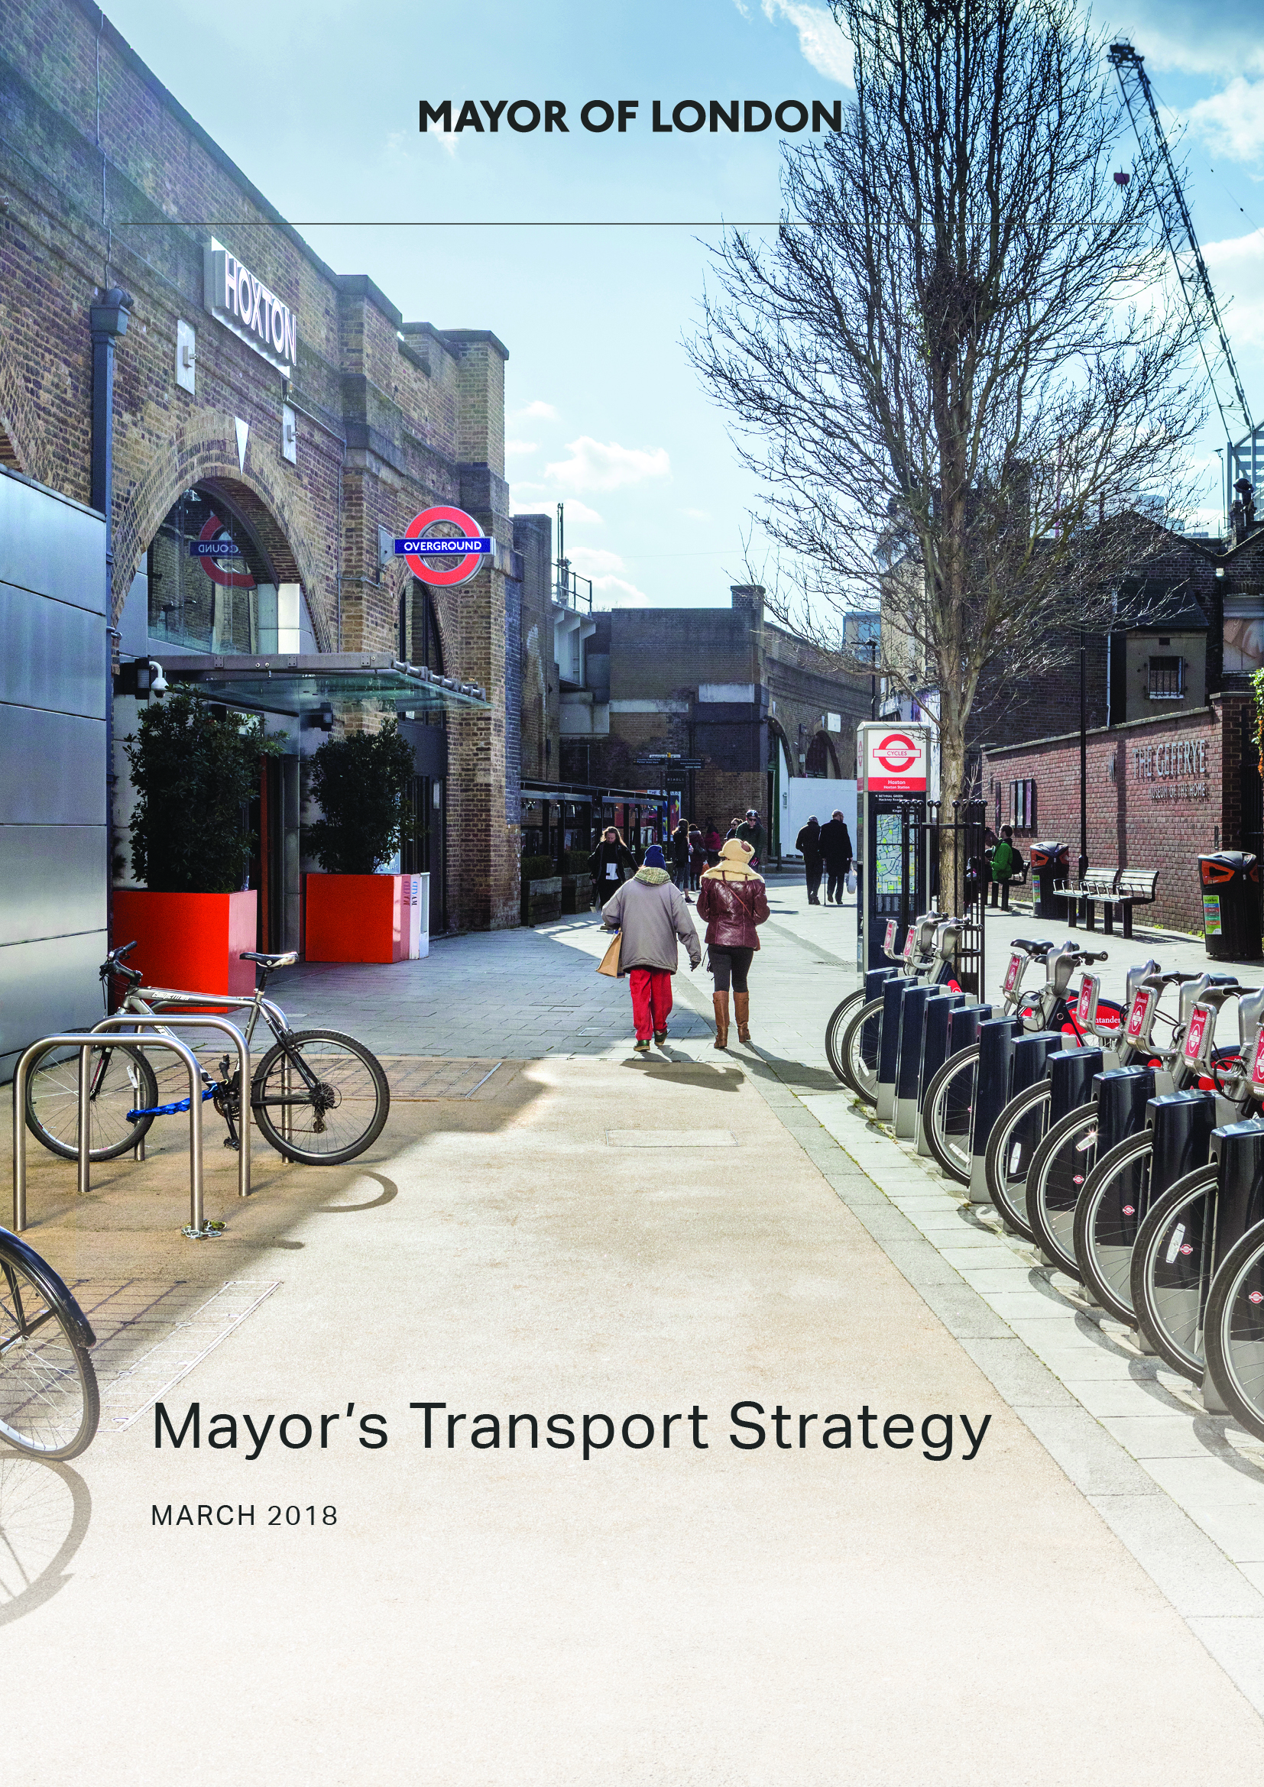
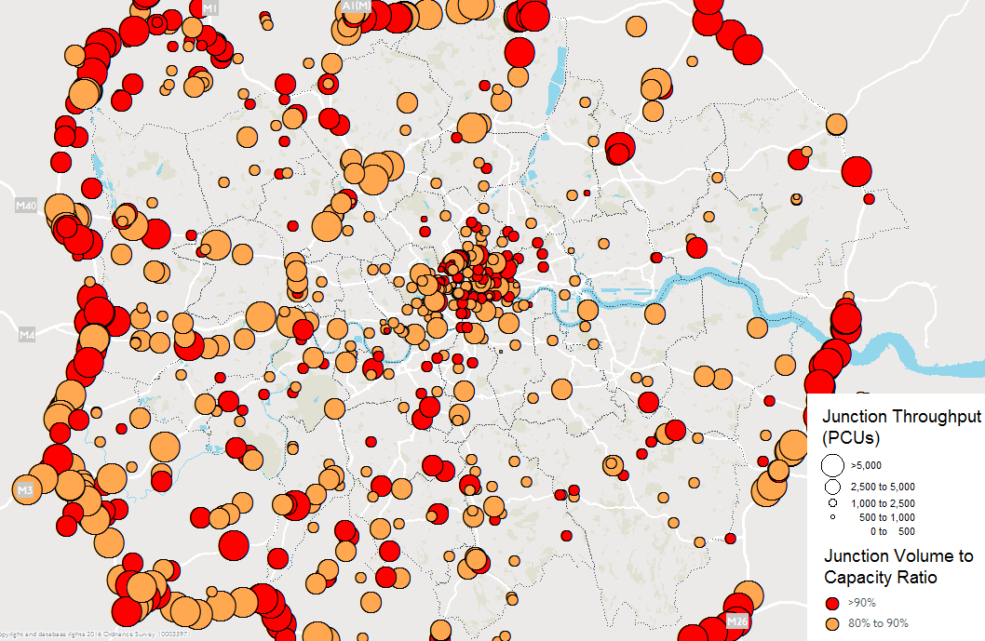
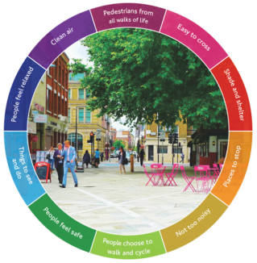
Mayor’s Transport Strategy
Comparison of capacity and flow at junctions, 2041,
without the MTS
Our overarching goal is for 80 per cent of all journeys to be made on foot, bicycle or by public transport by 2041, which is a sizeable shift from the 63 per cent today
By 2026 we need to reduce the number of freight trips during the morning peak by 10% within central London
Comparison of capacity and flow at junctions, 2041,
with the MTS
Falling car use and more efficient freight activity reduces overall traffic levels by 10-15%. Traffic congestion remains broadly at today’s levels during peak periods in 2041.

Slide 3
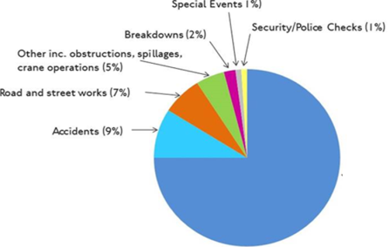
Impact of deliveries and servicing trips
Panel vans represent 50% of freight during the morning peak
Construction
75% of all congestion is caused by the scale of the demand
75%

Slide 4
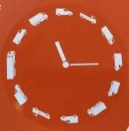
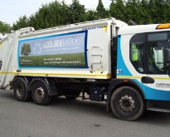

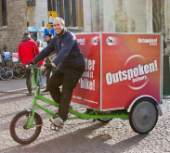
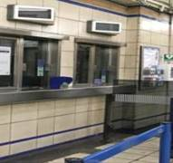
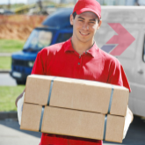
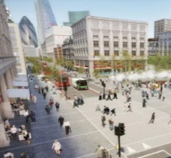

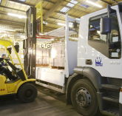
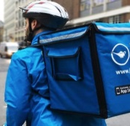
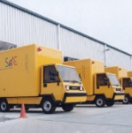
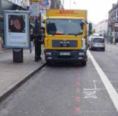

What are TfL doing?
Enable and encourage customers and businesses to avoid impacts of crowding and congestion
Retiming Deliveries Toolkit
Waste Consolidation Toolkit
Load sharing Demonstrator
TfL Land
Personal Deliveries Toolkit
Transformational schemes
Major estates partnerships
Traffic data
Safety:
FORS
CLOCS
DVS
Pedestrian Porterage Demonstrator
Micro Consolidation & Consolidation centres
TLRN Kerbside loading, height and weight restrictions data
Preferred Supplier
Notes:
We are looking at other ways to reduce congestion, here are some of them but there are more including water and rail alternatives
External partnerships with business – transformational schemes, major estates and servicing sector
Demonstrators – testing different aspects, what can work for business and London, developing toolkits to support wider adoption of those that show benefit
Data – digitising LLCS, traffic data and loading, height and weight restrictions on TLRN
Toolkits – 3 published this year
TfL land - we are in the process of identifying any surplus land across our estate, some of which could be suitable for freight and servicing – aims to let surplus space
Safety, FORS, CLOCS, DVS
Environment - LoCity
Working together we want to tell others about those successes and how we worked in partnership to support the Mayor’s transport strategy. We would be happy to work with you to promote the good things you are doing

Slide 5
Freight expertise across TfL
Leading
our thinking
on the future
of London’s
streets to
reflect the MTS
incl. the strategic
approach to traffic
reduction, managing
freight and reducing
road danger
Alex Williams Director of City Planning
Enforcement and Work Related Road Risk
Director of City Planning
Transport Strategy
National
& Regional Partnerships
Leading TfL’s
Relationships with
key national
& regional freight stakeholders,
ensuring our work supports the industry’s priorities wherever possible
Delivery
Planning
Works
Master
Planning
Travel
Demand Management
Strategy
and
Network Development
Turning strategies and policies into action plans, integrating deliveries & servicing at the core of place-based schemes. Working with industry to raise environmental and safety standards, incl. FORS, CLOCS, Construction Logistics, DVS and LoCity
Partnerships with businesses
and other customers of deliveries
& servicing. Demo projects and toolkits to promote sustainable delivery and procurement. Data and products for the industry and its customers
Planning works and coordinating initiatives in collaboration with the construction sector to reduce network disruption
Delivering place change while ensuring essential delivery & servicing can take place
Notes:
At TfL we have expertise across all areas focused on freight
Transport strategy team ensure we reflect the MTS desired outcomes relating to freight
Delivery Planning team work with industry to ensure safety and environmental standards are set and achieved
Strategy and network development deliver the change to places using the healthy streets criteria, and ensure delivery and servicing can take place efficiently
Works Planning – work with industry to minimise network disruption
Nation and regional partnerships maintain dialogue with freight stakeholder representatives FTA and RHA
Enforcement team – are there to ensure compliance
TDM – next slide

Slide 6
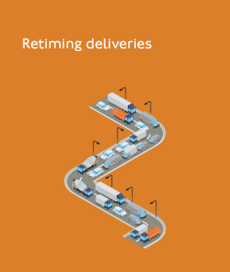

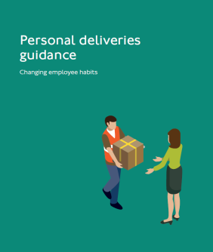
What can you do?
We need to reduce the number of freight trips during the morning peak by 10% within central London
How can we work together?
75%
Toolkits available tfl.gov.uk/efficientdeliveries

Slide 7
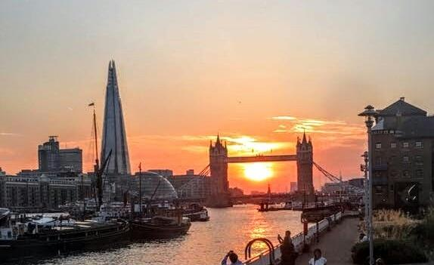
Contact
Clive Wanstall
clivewanstall@tfl.gov.uk
tfl.gov.uk/efficientdeliveries

